Slide 1


School of Computer Science and Engineering
Department of Computer Science and Engineering
PATH PULSE
Emphasizes awareness and intelligence in daily movement
SUBMITTED BY:
BHANI KAUR - 2427030487
VARSHITHA VASAGUDDAM-2427030516
SUPERVISED BY:
SHWETA SHARMA

Slide 2






OUTLINE
INTRODUCTION
LITERATURE REVIEW
PROBLEM STATEMENT
PROPOSED SOLUTION
OBJECTIVE
REFERENCES

Slide 3
01
Women’s safety during daily travel has become a major concern, especially when commuting alone or at late hours. Similar risks can also affect children, elders, and other individuals..
02
Many people follow fixed daily routes, and any sudden change or delay can signal potential danger. Tracking such movements can help identify unsafe situations early.
INTRODUCTION
03
This app aims to enhance safety by detecting unusual travel patterns and ensuring quick alerts to trusted contacts when something seems wrong.

Slide 4
LITERATURE REVIEW
Noonlight (formerly SafeTrek) :Emergency alerts,
hold-button /silent SOS features.
Life360:Real-time location sharing, geofencing, crash ,detection, emergency contacts. Could notice when user leaves expected zone
Existing safety apps rely on manual trigger;few use behavioral learning for proactive alerts.
This project fills the gap by combining routine learning with
real-time alerting, tailored to individual movement patterns.
Time-series models like LSTM and clustering algorithms(K-Means, DBSCAN) are effective for identifying deviations in sequential data.

Slide 5
Paper Name | Abstract | Technology Used | Result | Conclusion
Routine Pattern Discovery and Anomaly Detection in Individual Travel Behavior (Sun et al., 2023) | Explores spatiotemporal travel behavior and discovers routine movement patterns. Uses probabilistic modeling to detect anomalies in daily travel routes. | 2D-LDA (Two-Dimensional Latent Dirichlet Allocation), unsupervised learning on trajectory/LPR datasets. | Successfully identifies unusual trips by comparing them with learned daily patterns. | Probabilistic topic models work well in capturing sparse human travel behavior and detecting deviations.
Mobile Trajectory Anomaly Detection: Taxonomy, Methodology, Challenges, and Directions (Kong et al., 2024) | A complete survey of anomaly detection in mobile trajectories. Defines anomaly types and compares common algorithms. | Deep learning, clustering, density-based models, sequential modeling, mobility data processing. | Provides a unified taxonomy and shows strengths/weaknesses of existing models. | Future systems must focus on privacy, real-time detection, sparse-data handling, and interpretability.
Threat Eye – Safety Alert System for Real-Time Threat Detection | Develops an Android app that sends rapid SOS messages and shares live location when the user is in danger. | Android Studio, GPS, SMS/Internet communication, mobile UI. | Successfully sends emergency alerts and shares real-time location with trusted contacts. | Smartphone-based alert systems improve personal safety by enabling quick emergency communication.
Feasibility of Anomalous Event Detection Using Mobile Spatial Statistics (Mas & Koshimura, 2024) | Examines whether aggregated mobile location data can detect population anomalies related to events/disasters. | Mobile Spatial Statistics (MSS), spatial-temporal anomaly detection. | Found that unusual spikes/drops in population movement align with known events. | MSS is useful for large-scale anomaly detection but requires calibration for biases and local patterns.
Anomaly Detection & Mobile Network Security Enhancement Using K-Means on CDRs (Aziz & Bestak, 2024) | Uses clustering on call detail records to detect suspicious or unusual mobile network behavior. | K-means clustering, CDR analytics, large-scale data processing. | Achieved high anomaly detection accuracy using telecom data patterns. | CDR-based clustering is effective for detecting network threats and security anomalies.

Slide 6
PROBLEM STATEMENT
In today’s world, personal safety has become a growing concern, especially for individuals who travel alone or at odd hours. Existing safety apps rely on manual alerts, which may not be possible during emergencies. There is a need for an intelligent system that can automatically learn a person’s daily travel routine, detect unusual route deviations or timing anomalies in real time, and alert trusted contacts without requiring user intervention.

Slide 7
OBJECTIVE
To develop a smart safety application that ensures quick and reliable emergency response for users.
To enhance personal safety, especially for women and vulnerable individuals, through AI and real-time monitoring.
To detect unusual or risky situations automatically using machine learning and location tracking.
To enable hands-free emergency alerts using voice activation and custom code words.
To build community awareness and cooperation through a connected safety network.

Slide 8
METHODOLOGY
Y
System Architecture & Technologies
Methodology – System Architecture
• The system is developed as a web-based safety application using Flask.
• It follows a client–server architecture.
Frontend:
HTML, CSS, Bootstrap
JavaScript for location handling
Responsive dashboard interface
Backend:
Python Flask framework
Handles location processing and anomaly detection
Database:
SQLite database (routes.db)
Stores latitude, longitude, and timestamp
APIs Used:
Browser Geolocation API
Google Maps for live location display

Slide 9
Real-Time Location Collection & Storage
Methodology – Location Tracking
The system collects the user’s real-time location using the Geolocation API.
Steps:
User opens the Dashboard
Browser requests location permission
Latitude and longitude are captured automatically
Location is displayed on:
Dashboard coordinates
Google Map view
Data Storage:
Each location is sent to Flask backend
Backend stores data in SQLite with timestamp
This creates a continuous travel history

Slide 10
Routine Learning & Anomaly Detection
Proposed Methodology – Intelligent Monitoring
The system first learns the user’s normal travel behavior.
Routine Learning
Initial location records are collected
System calculates the average latitude and longitude
This average represents the routine location area
Anomaly Detection
Each new location is compared with routine location
Distance is calculated using coordinate difference
If distance exceeds predefined threshold → SOS Status
Otherwise → SAFE Status
This enables automatic abnormal movement detection without manual input.

Slide 11
Alert Mechanism & User Interface
Proposed Methodology – Response & Visualization
Alert System:
SAFE → Green status displayed
SOS → Red alert with warning message
Automatic detection based on location deviation
User Interface Features
Modern dashboard with gradient design
Live Google Map display
Real-time coordinates
Safety status indicator
Location history page
Navigation between Home, Dashboard, and History
Outcome
A complete real-time personal safety monitoring system with automated risk detection and history tracking.

Slide 12
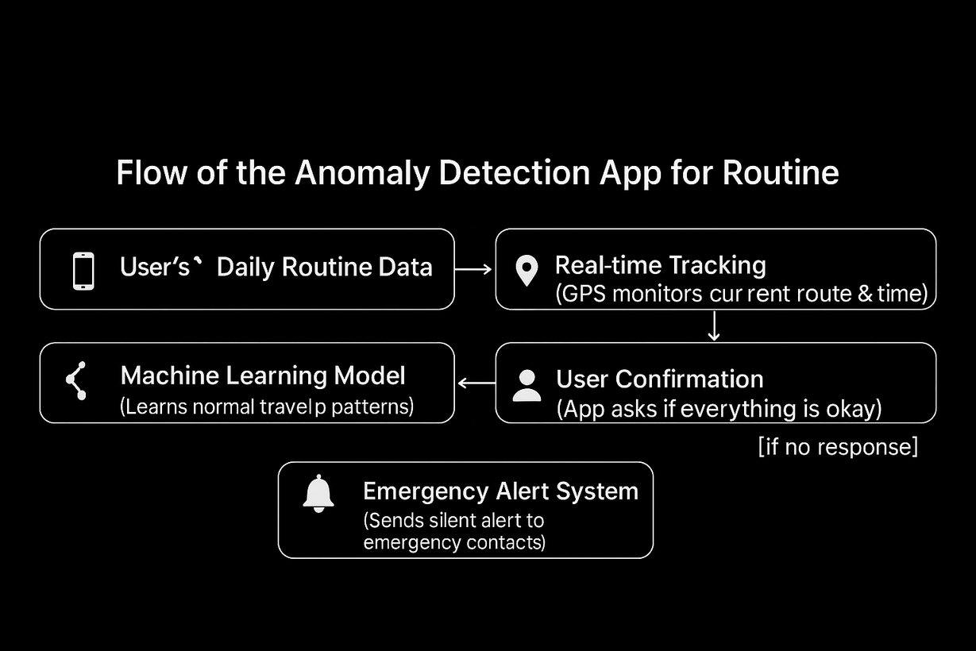
WORKING

Slide 13
REFERENCES
1.https://www.kaggle.com/
2.https://github.com/
3.https://openai.com/index/chatgpt/
4.scholar.google.comGoogle Scholar
1. Routine Pattern Discovery and Anomaly Detection in Individual Travel Behavior IDEAS/RePEc+2IDEAS/RePEc+2
Reference: Sun, L., Chen, X., He, Z., & Miranda-Moreno, L. F. (2023). Routine Pattern Discovery and Anomaly Detection in Individual Travel Behavior. Networks and Spatial Economics, 23(2), 407-428.
2. Mobile Trajectory Anomaly Detection: Taxonomy, Methodology, Challenges, and Directions DBLP+1
Reference: Kong, X., Wang, J., Hu, Z., He, Y., Zhao, X., & Shen, G. (2024). Mobile Trajectory Anomaly Detection: Taxonomy, Methodology, Challenges, and Directions. IEEE Internet of Things Journal, 11(11), 19210-19231.
3. An Application of Safety Alert System for Real Time Threat … ijser.in
Reference: (2023). An Application of Safety Alert System for Real Time Threat Detection (Android Application), IJSER
4. Feasibility of Anomalous Event Detection Based on Mobile Spatial Statistics (MSS) Direct
Reference: Mas, E., et al. (2024). Feasibility of anomalous event detection based on Mobile Spatial Statistics (MSS). Computers, Environment and Urban Systems
5. Insight into Anomaly Detection and Prediction and Mobile Network Security Enhancement Leveraging K-Means Clustering on Call Detail Records PI
Reference: Aziz, Z., & Bestak, R. (2024). Insight into Anomaly Detection and Prediction and Mobile Network Security Enhancement Leveraging K-Means Clustering on Call Detail Records. Sensors, 24(6):1716.
6.https://www.youtube.com
7
• Flask Documentation – https://flask.palletsprojects.com/
• Python Documentation – https://docs.python.org/3/
• SQLite Documentation – https://www.sqlite.org/docs.html
• Geolocation API – https://developer.mozilla.org/en-US/docs/Web/API/Geolocation_API
• Google Maps Embed API – https://developers.google.com/maps/documentation/embed
• Bootstrap Framework – https://getbootstrap.com/

Slide 14
Thank you

